Slide 1

GRE CRACK COURSE
Zihad Azad
NANOPHOTONIC RESEARCH GROUP
EEE, BUET
GRE Score: 336
Quant: 167, Verbal: 169

Slide 2
WHAT IS GRE?
GRADUATE RECORD EXAMINATION
A COMPULSORY FOR ALMOST ALL POST-GRADUATE PROGRAMS IN USA
EVEN BUSINESS INSTITUTIONS NOW PREFER GRE OVER GMAT
ALSO COMPULSORY/PREFERRED IN TOP-TIER EUROPEAN UNIVERSITIES

Slide 3
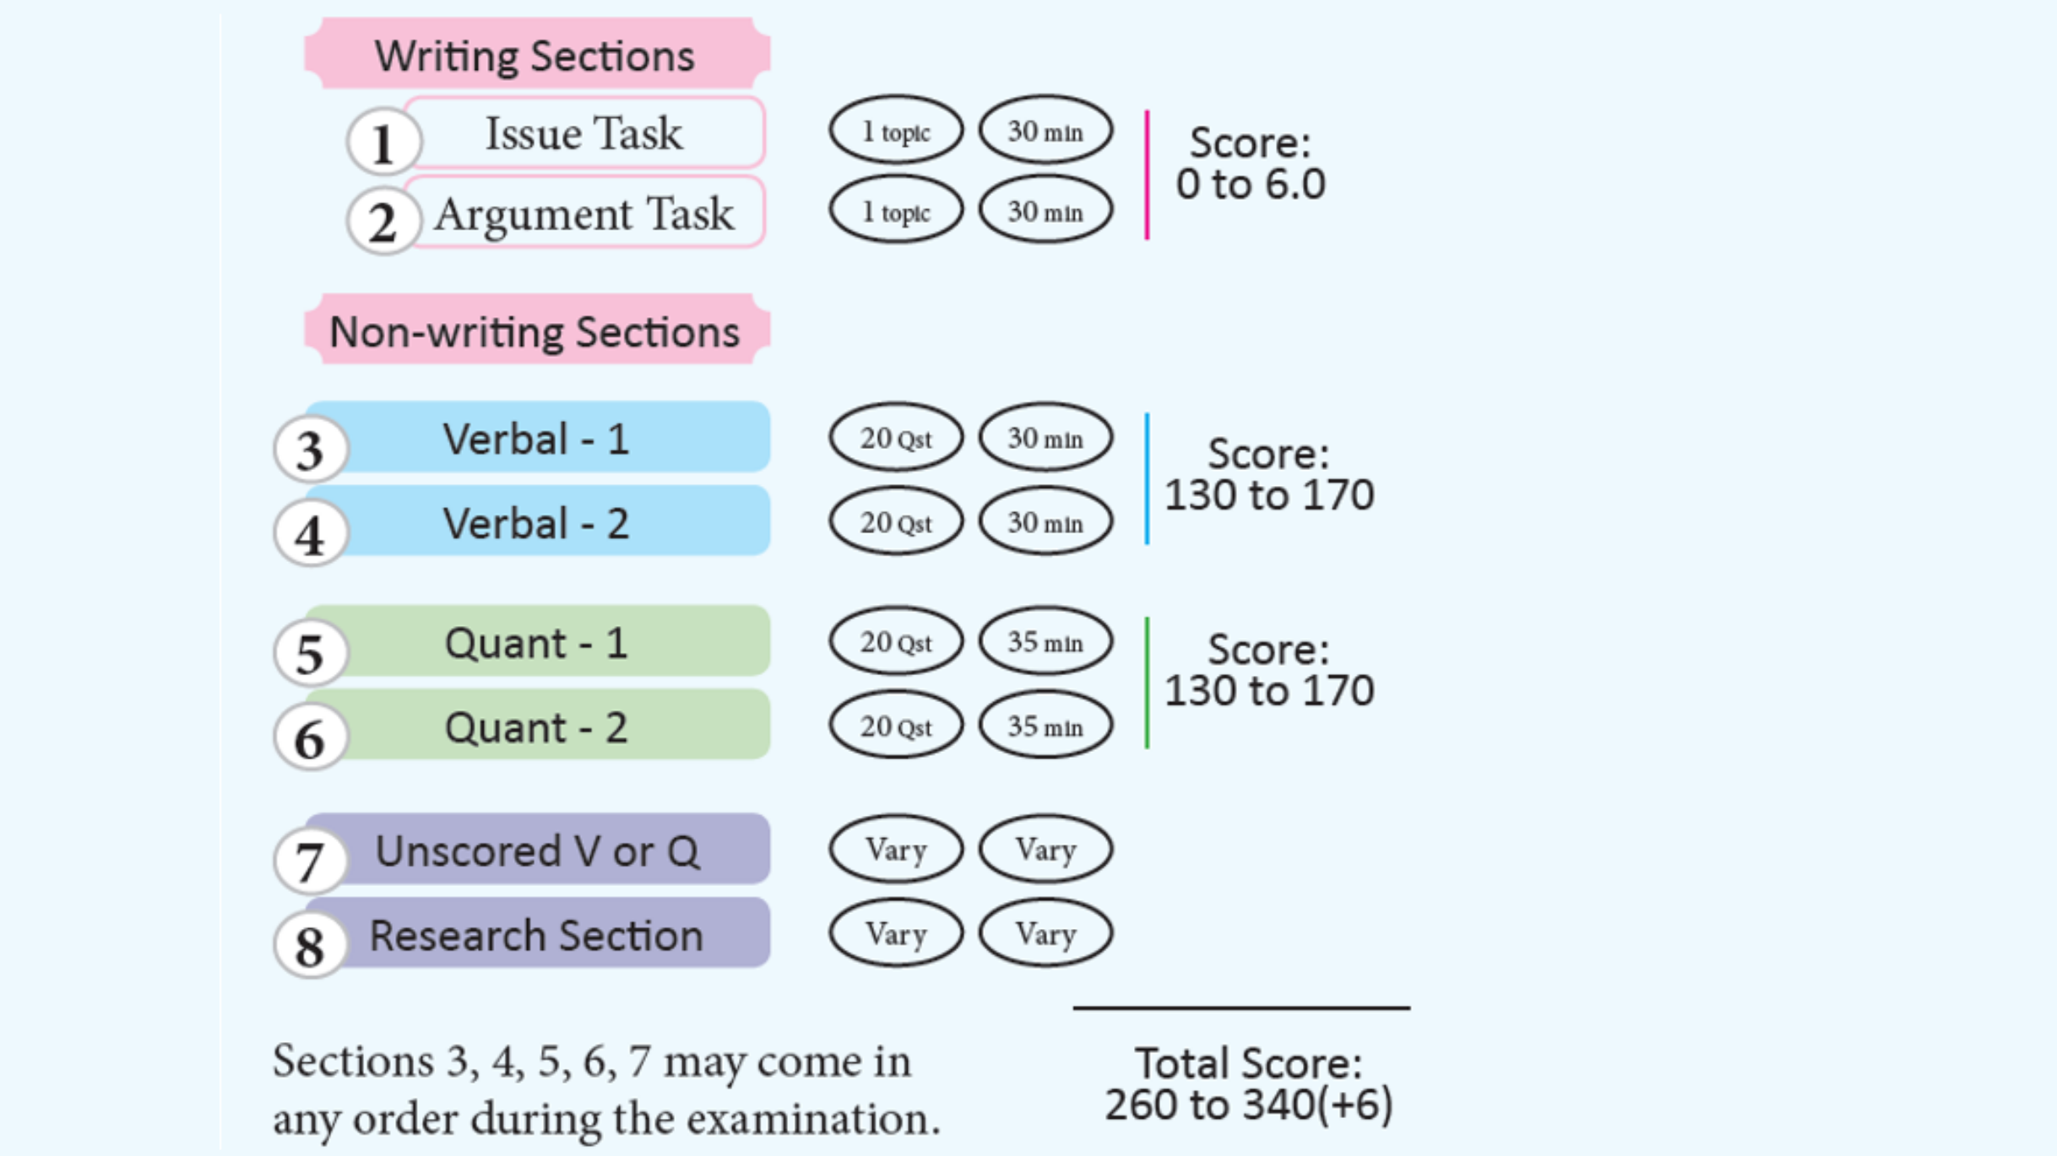
EXAM BREAKDOWN

Slide 4
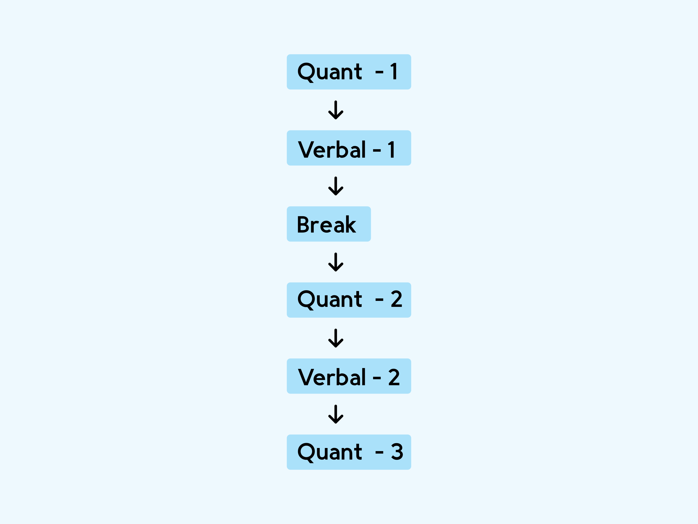
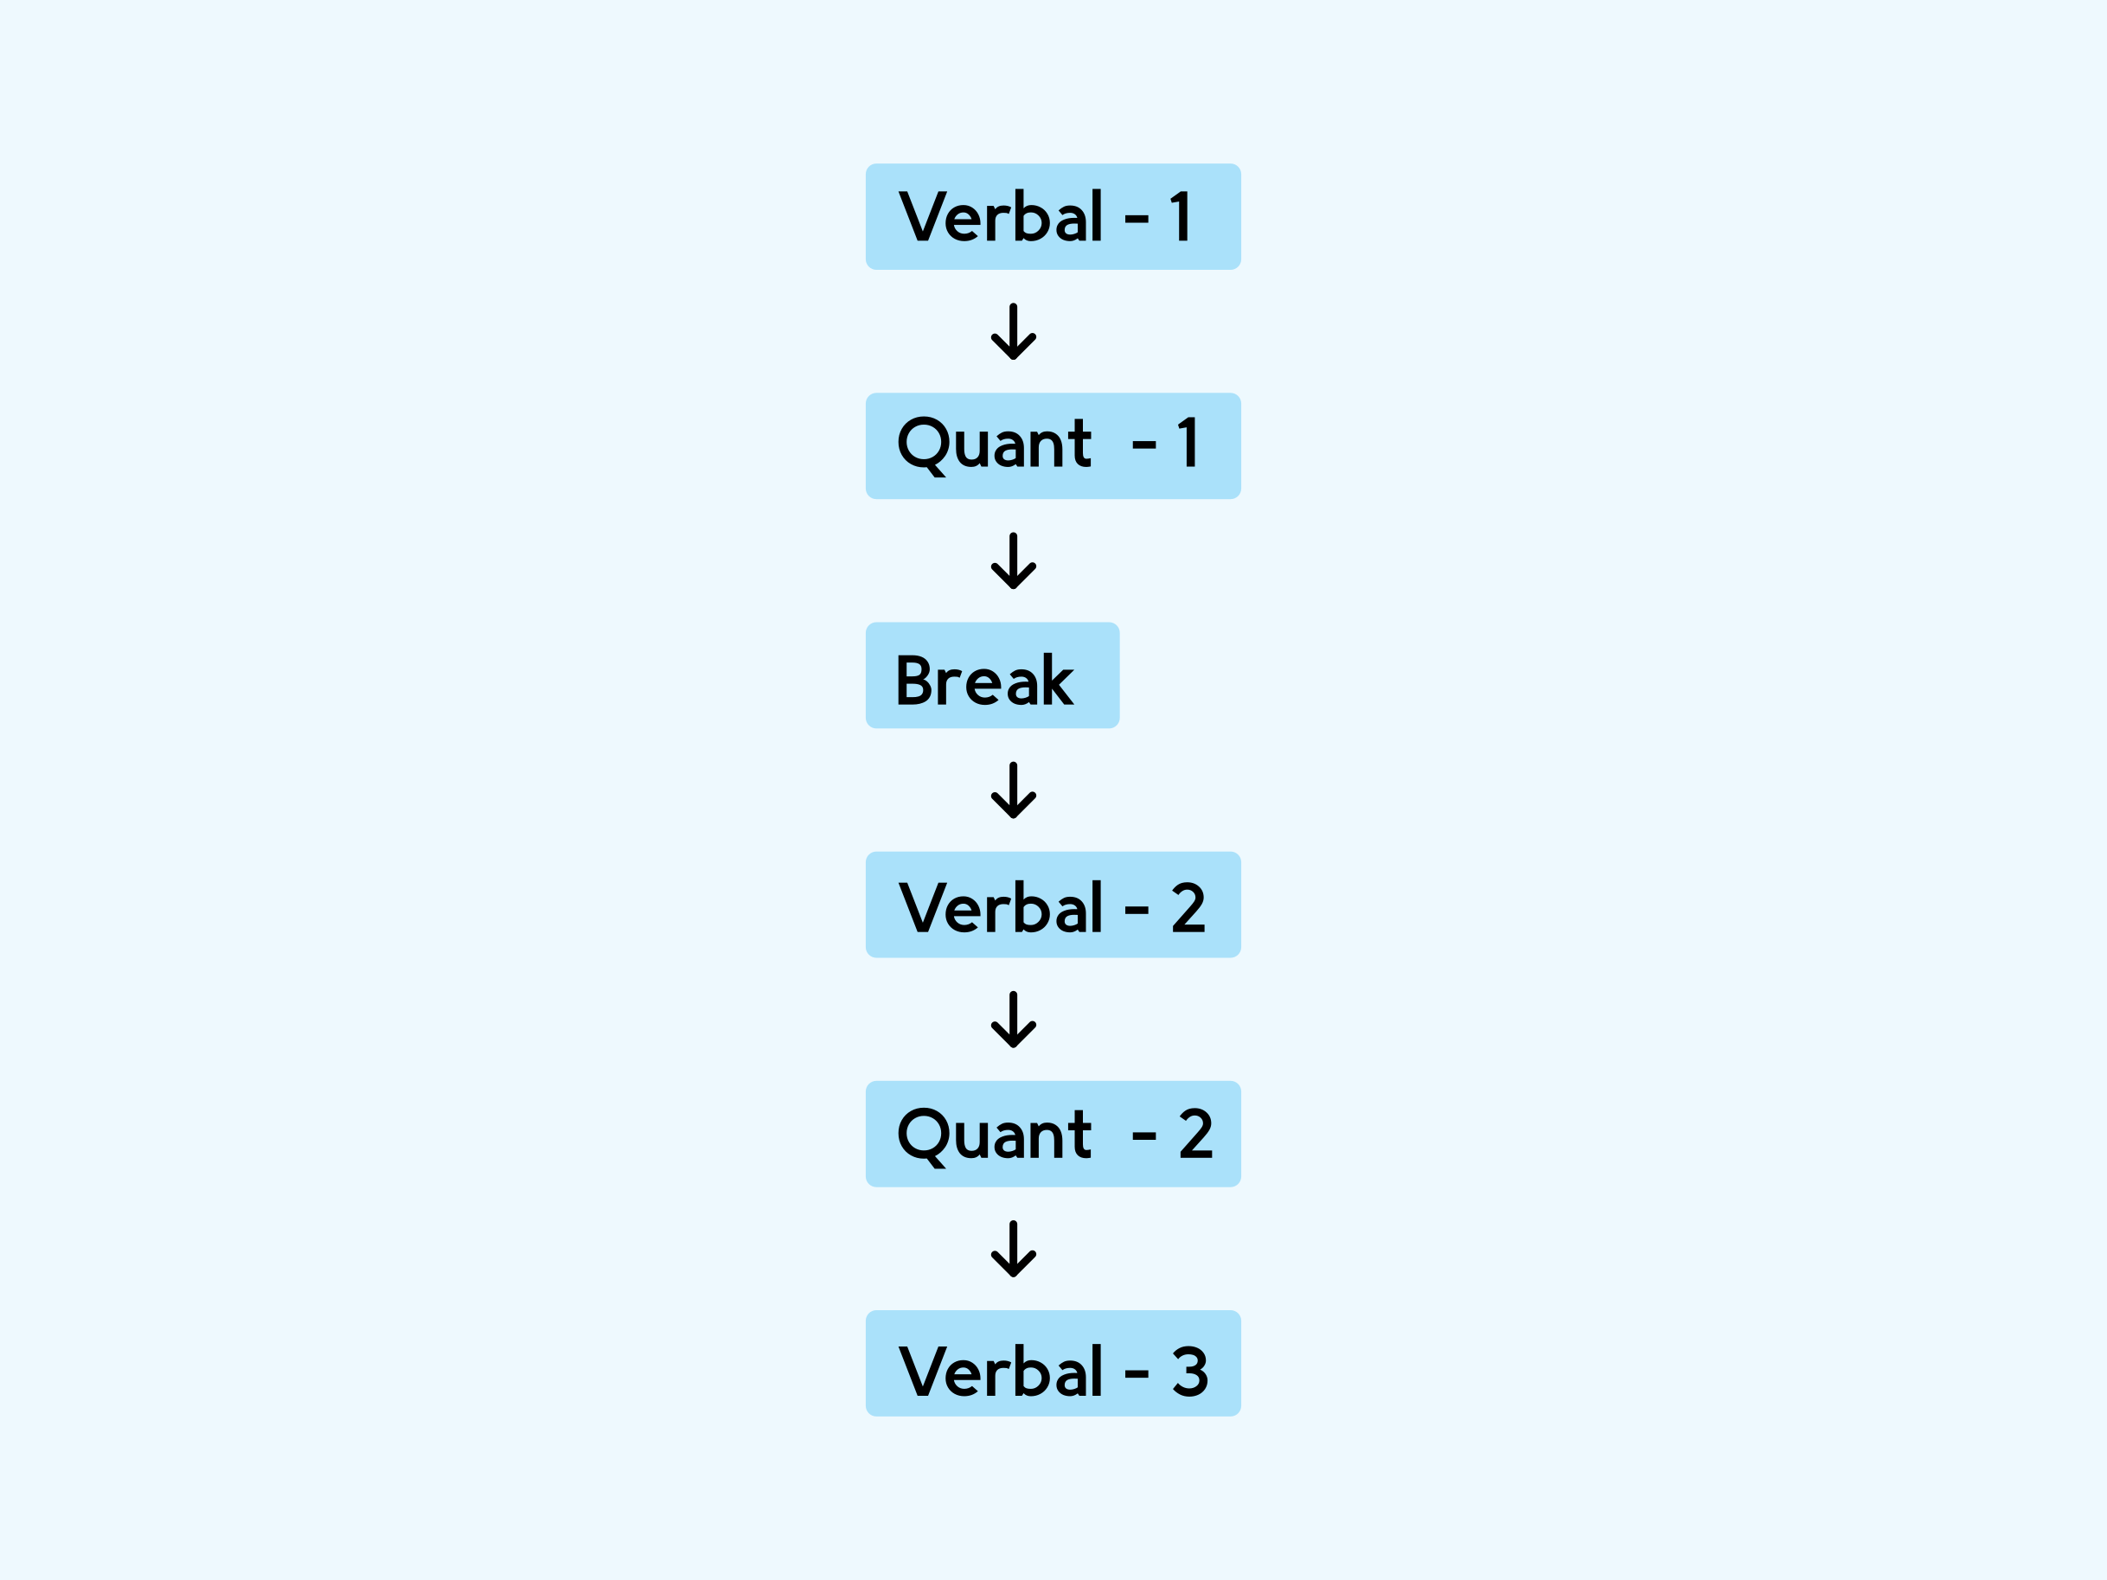
WHICH ONE WOULD YOU CHOOSE?

Slide 5
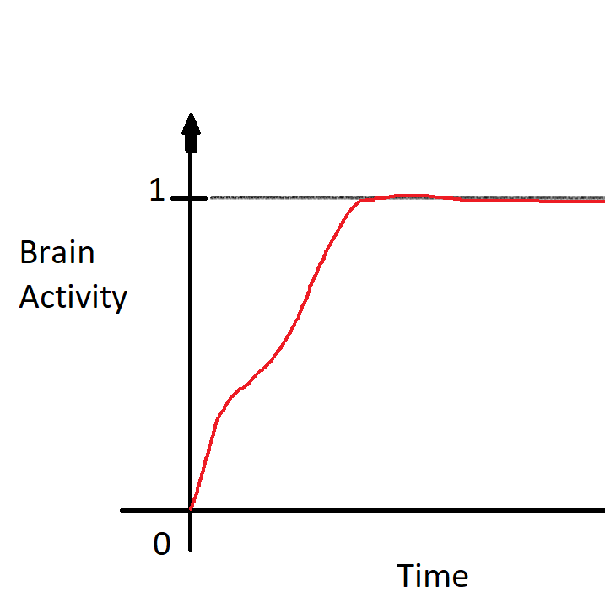
BRAIN ACTIVITY WHILE SOLVING A VERBAL PROBLEM

Slide 6
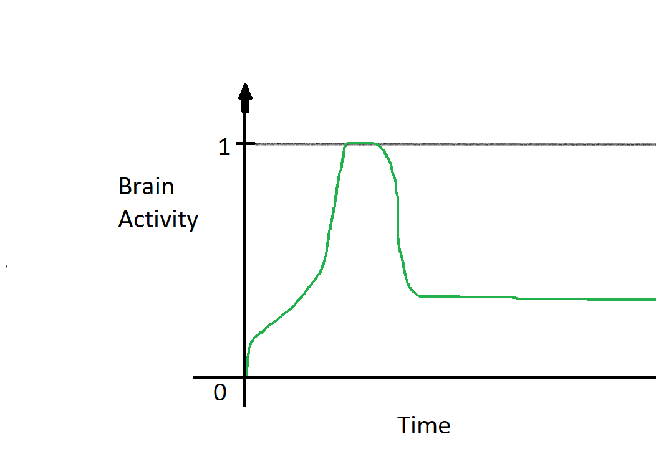
BRAIN ACTIVITY WHILE SOLVING A QUANT PROBLEM

Slide 7
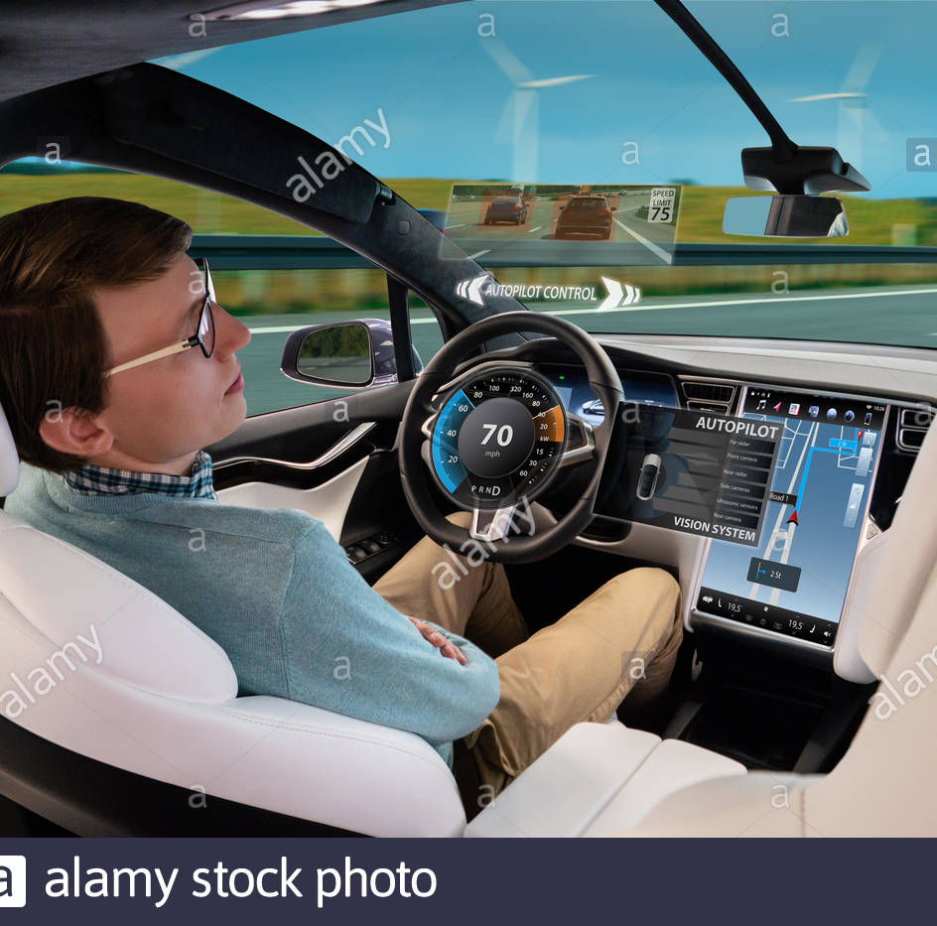
YOUR BRAIN GOES INTO AUTOPILOT MODE

Slide 8
SECTION SUBCATEGORIES
QUANT: ARITHMETIC, GEOMETRY, COUTING, PROBABILITY, STATISTICS….
VERBAL: TEXT COMPLETION, SENTENCE EQUIVALENCE, READING COMPREHENSION

Slide 9

WHY IS GRE VERBAL SO HARD?

Slide 10

IT ALL STARTS WITH ENGLISH FOR TODAY
MARY HAS A LITTLE LAMB. I GO TO SCHOOL. HE EATS RICE. LIFE IS TOUGH. WE SHALL OVERCOME ONE DAY……………………….. ON AND ON IT GOES

Slide 11
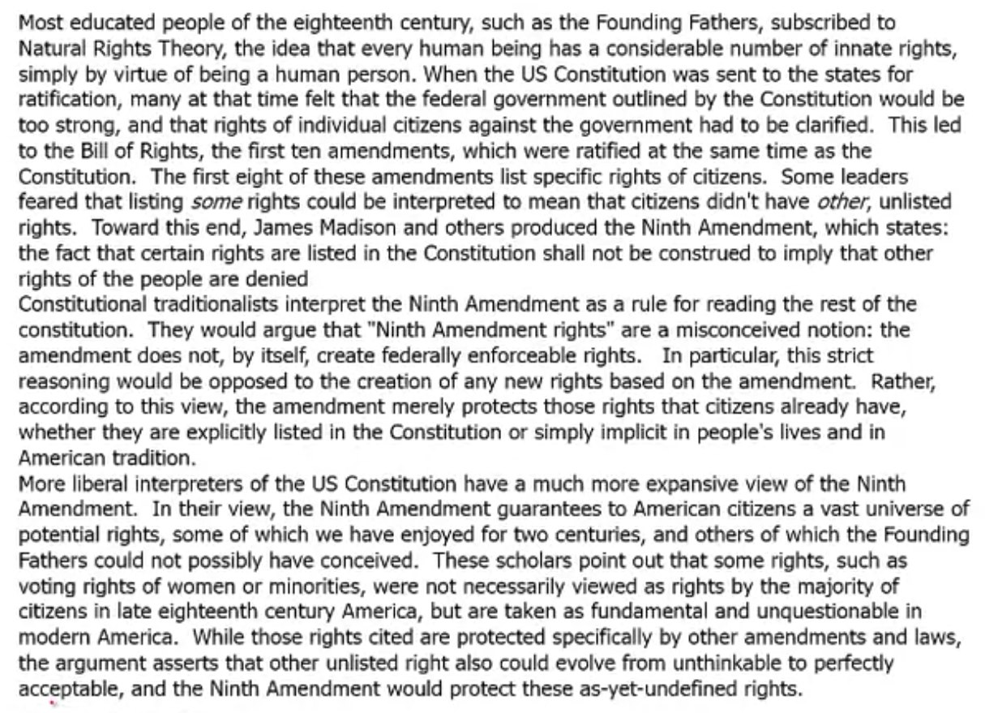
A HUGE LEAP IN COMPLEXITY

Slide 12
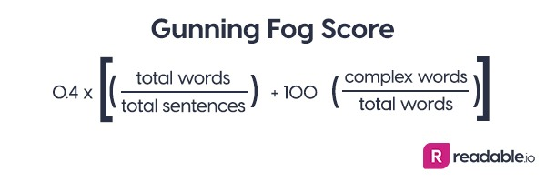
THE DIFFERENCE LIES IN SYNTACTIC COMPLEXITY

Slide 13
GUNNING FOG SCORE
DAILY STAR EDITORIAL: 8-10
GRE VERBAL PASSAGES: 18-20!!!

Slide 14
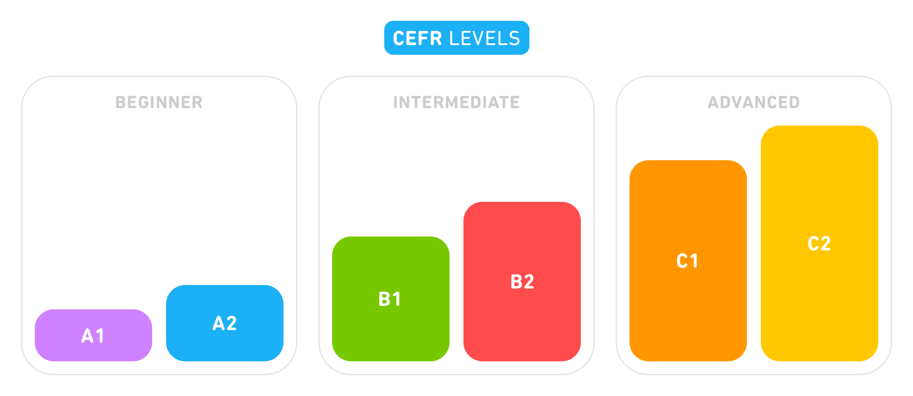
GRE IS A C2 STANDARD EXAM IN THE EUROPEAN CEFR SCALE
GRE
TOEFL
IELTS

Slide 15
THE SUBCATEGORIES OF THE VERBAL SECTION
READING COMPREHENSION
TEXT COMPLETION (SINGLE, DOUBLE AND TRIPLE BLANK)
SENTENCE EQUIVALENCE

Slide 16
TEXT COMPLETION
BLANK 1, 2 & 3

Slide 17
A SIMPLE FLOWCHART TO SOLVING TC
READ THE ENTIRE SENTENCE(S)
BREAK IT DOWN IN PARTS, TRY TO UNDERSTAND THE RELATION BETWEEN DIFFERENT PARTS USING THE FLAGPOSTS
COME UP WITH A GUESS WORD FOR THE BLANK(S)
MATCH WITH THE GIVEN ANSWER CHOICES AND ELIMINATE
UNDER NO CIRCUMSTANCE WILL YOU CHECK OUT THE ANSWER CHOICES FIRST

Slide 18
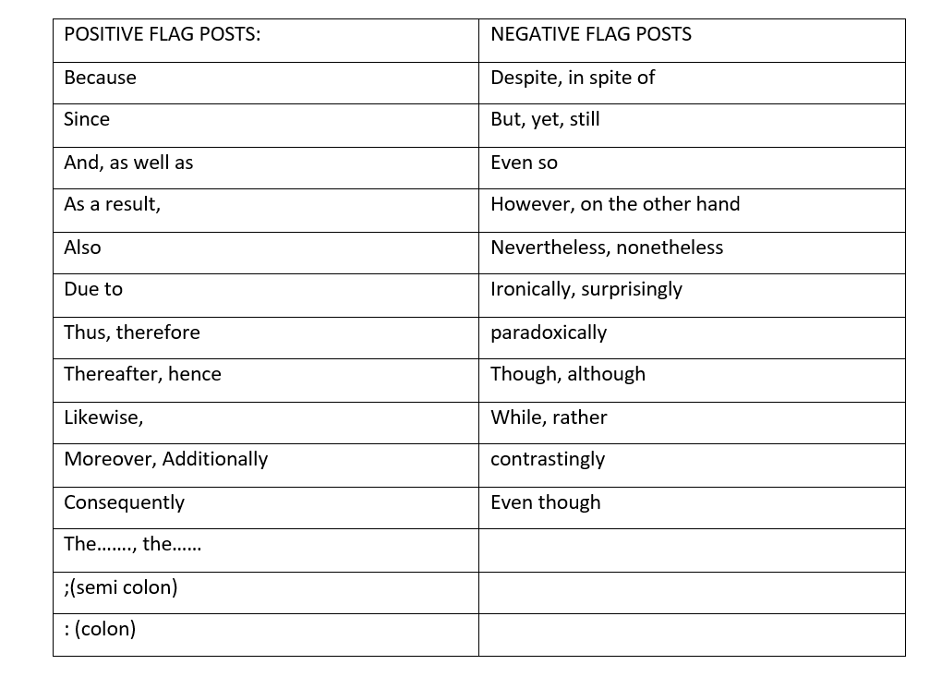
FLAGPOSTS!

Slide 19
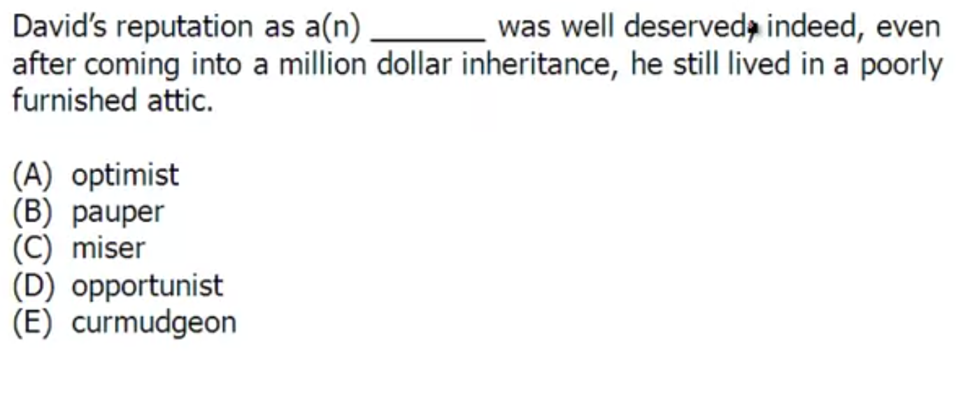
TC1: EXAMPLE

Slide 20
THE SOLUTION

Slide 21
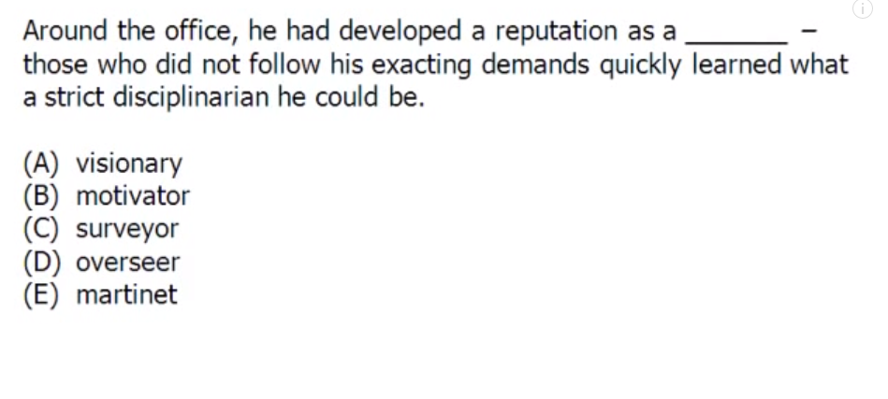
YOU TRY THIS ONE!

Slide 22
THE ANSWER CHOICE

Slide 23
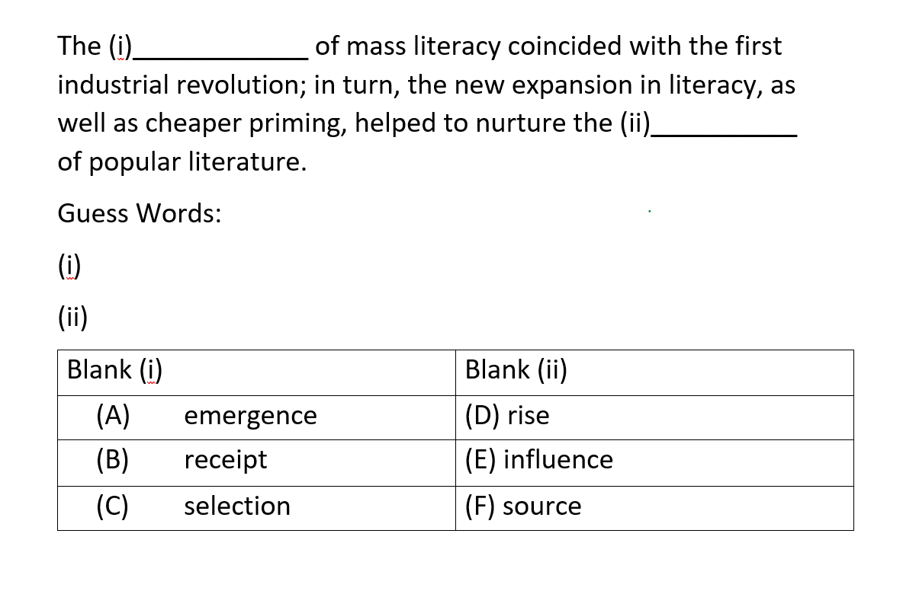
TEXT COMPLETION:BLANK 2 EXAMPLE

Slide 24
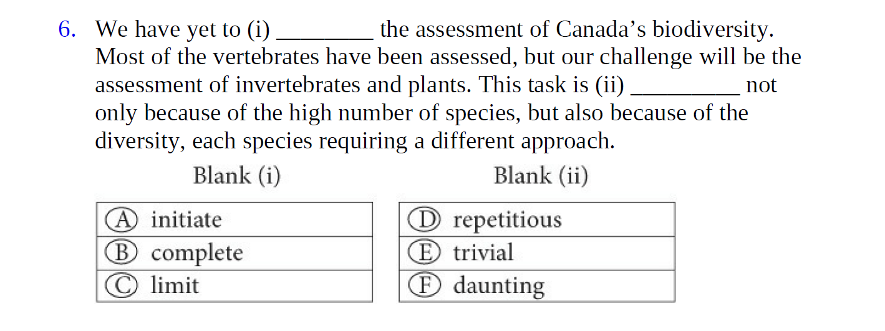
YOU TRY THIS ONE

Slide 25
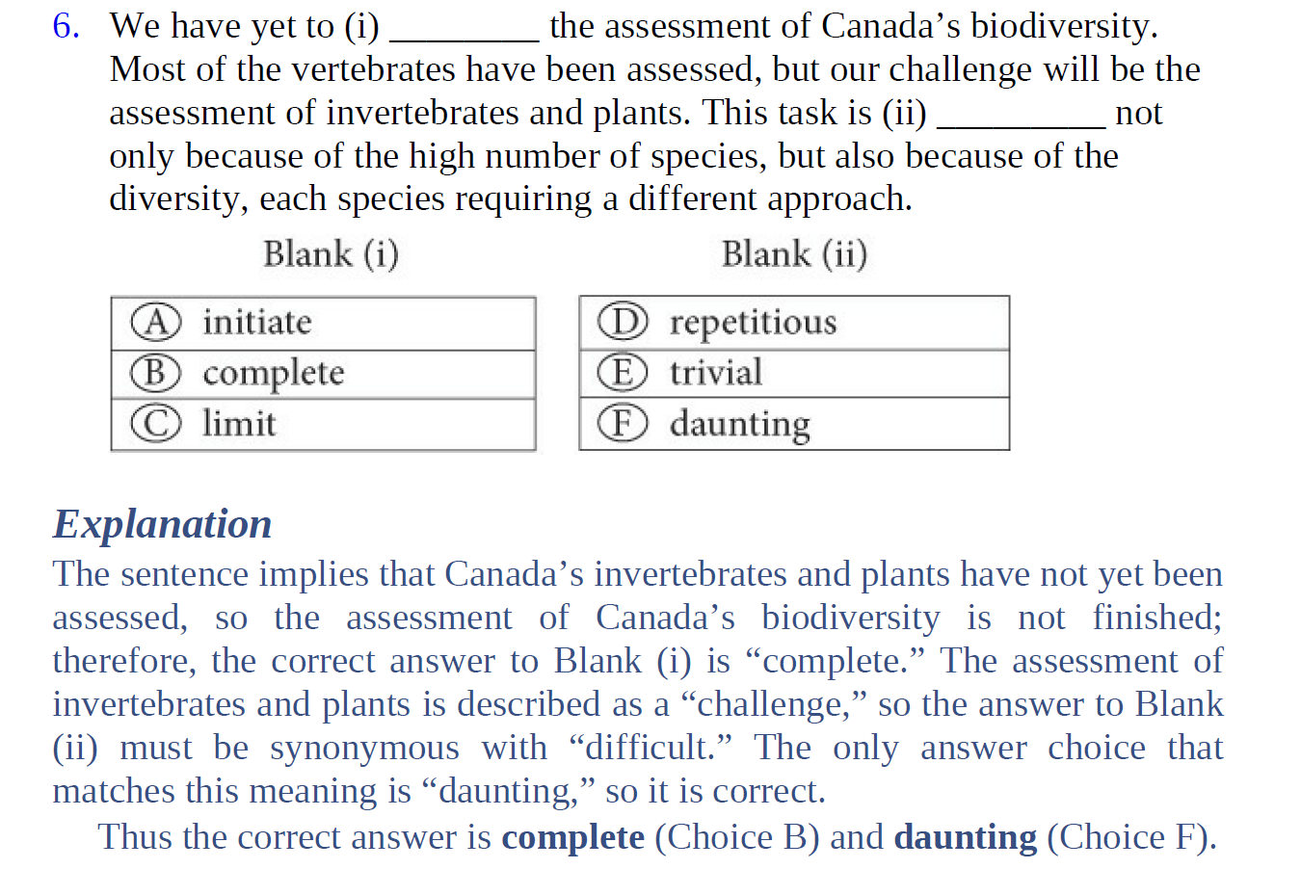

Slide 26
SENTENCE EQUIVALENCE
EXACTLY LIKE TC1, BUT WITH TWO ANSWER CHOICES
THE TWO ANSWERS DO NOT NECESSARILY HAVE TO BE SYNONYMS
AFTER PLUGGING IN THE CHOICES, YOU WILL GET TWO SENTENCES.
THE TWO SENTENCES HAVE TO BE FUNCTIONALLY EQUIVALENT
SENTENCE 1 = SENTENCE 2

Slide 27
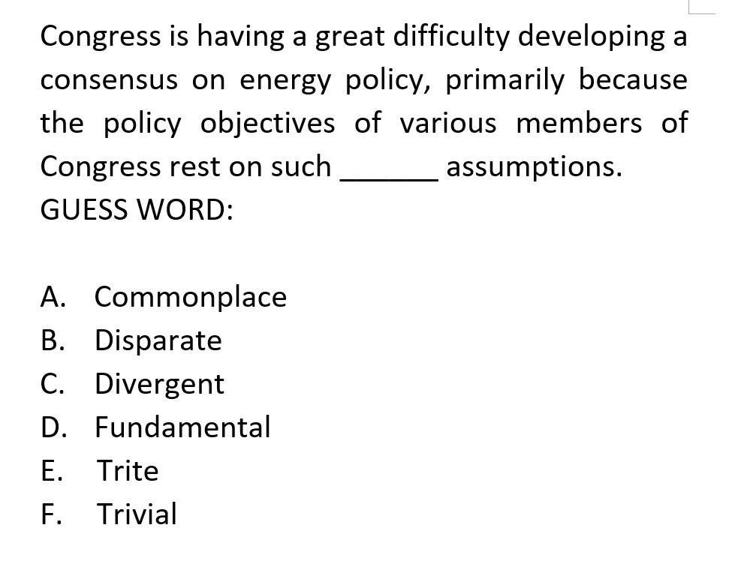
SENTENCE EQUIVALENCE

Slide 28
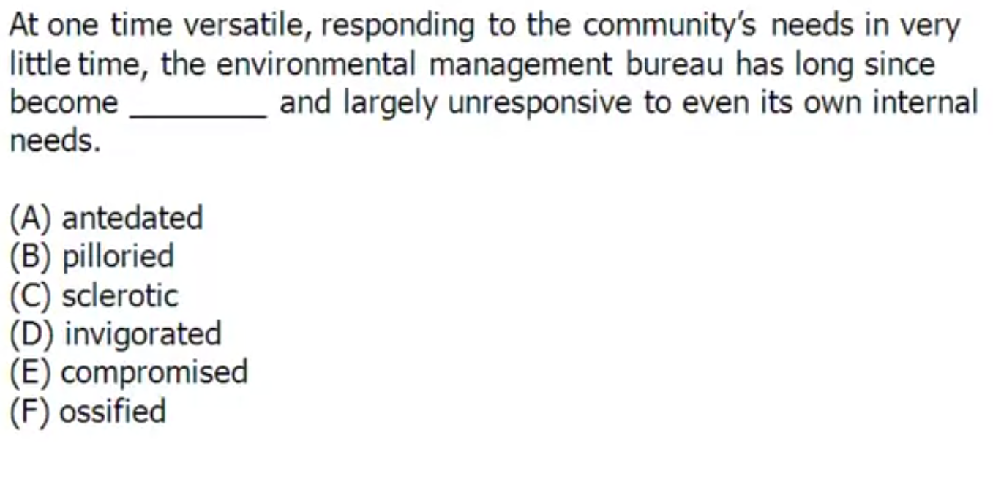
YOU TRY THIS ONE!

Slide 29
THE SOLUTION

Slide 30
TEXT COMPLETION BLANK 3
THE HARDEST QUESTION CATEGORY IN GRE VERBAL
VERY TIME CONSUMING
POSSIBILITY OF GETTING IT 100% RIGHT IS PRETTY LOW
WE CANNOT ALWAYS COME UP WITH A GUESS WORD. IN THAT CASE, WE WILL CONTINUE WITH A GENERAL SENSE.
THE TYPICAL SOLUTION FLOWCHART APPLIES HERE.

Slide 31
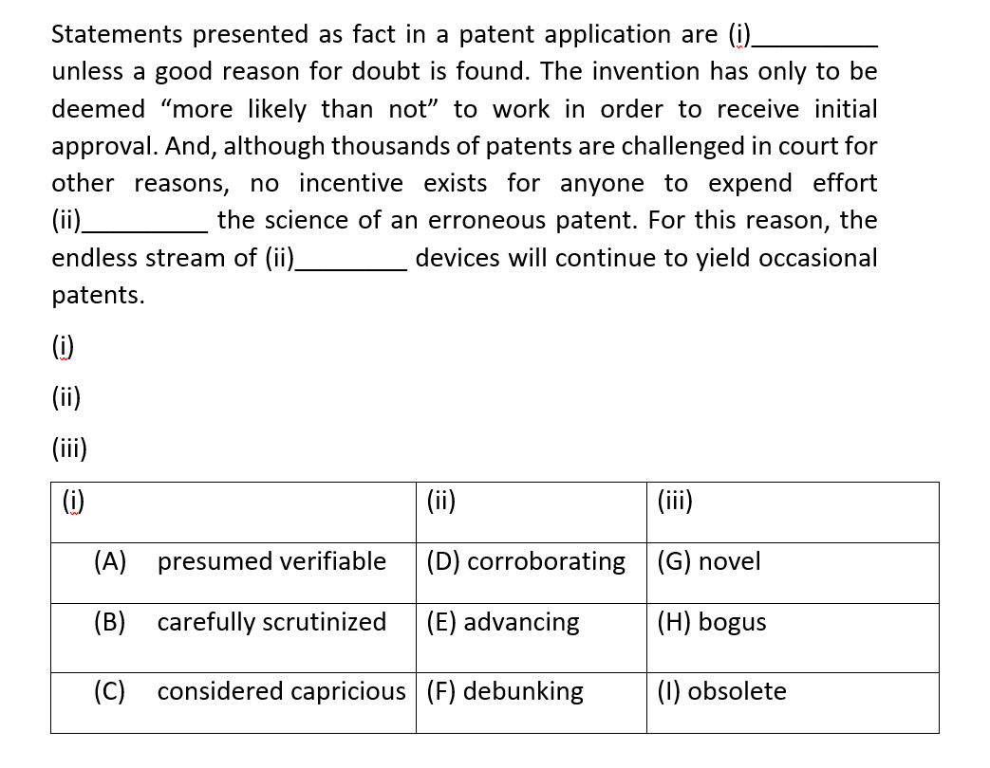

Slide 32
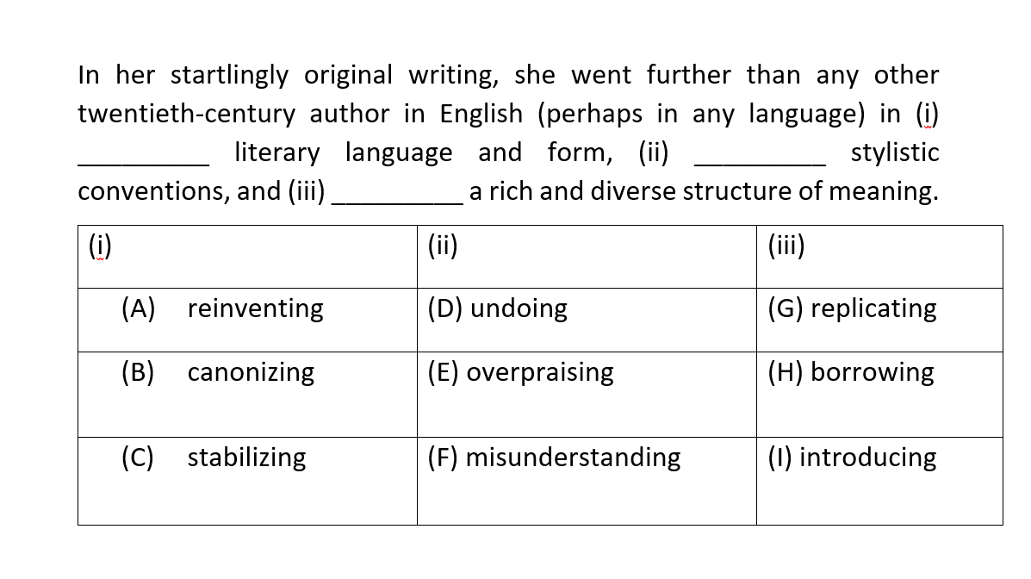

Slide 34
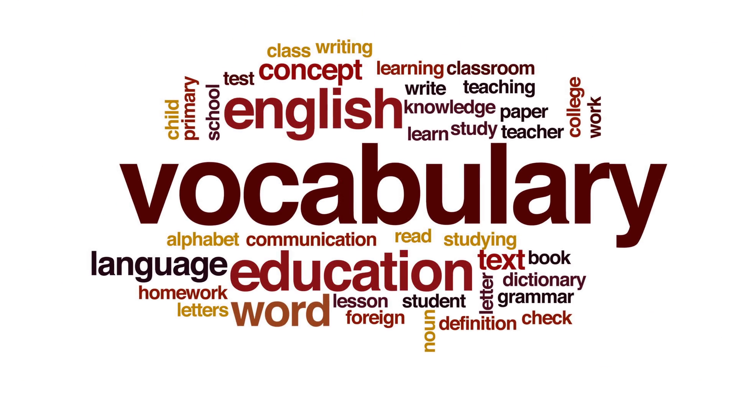

Slide 35
MUST-HAVE BOOK-LIST
The Official Guide to the GRE General Test
5 Lb. Book of GRE Practice Problems (MATH ONLY!!)
Official GRE Quantitative Reasoning Practice Questions
Official GRE Verbal Reasoning Practice Questions
GRE Big Book
GRE VERBAL GRAIL ***

Slide 36


BEST RESOURCE FOR VERBAL OUTSIDE ETS

Slide 37
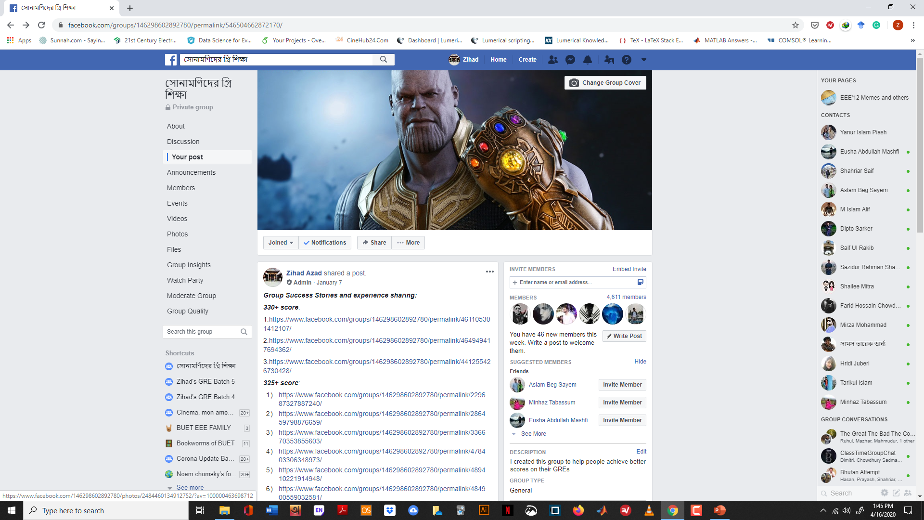

Slide 38


Slide 39


Slide 40


